Slide 1
PyFamilyTree
Phase 2 Software Design Descriptions

Slide 2
Agenda
Introduction
System Architecture
Database Schema
GUI
GUI Transition Diagram
Sequence Diagrams
User Manual Sample
Questions

Slide 3
Introduction
Purpose:
This Software Design Presentation (SDD) describes the architecture and design of the PyFamilyTree App. The intended audience for this presentation are all stakeholders.
Scope:
PyFamilyTree is a web-based family tree application that allows users to create and maintain family trees, add members, and keep track of genealogical information. The goals are to provide a user-friendly and secure app, handling high traffic and large amounts of data.
Overview:
This presentation and its associated document will provide a detailed overview of the PyFamilyTree app and its organization. It outlines the system architecture, data design, component design, and human interface design.
The document also includes a requirements matrix to trace system components to the requirements outlined in the Software Requirements Specification document.

Slide 4
System Architecture
Architectural Design:
The PyFamilyTree app is designed used a 3-tier architecture consisting of a presentation layer, an application layer, and a database layer.
Decomposition Description:
The PyFamilyTree app is decomposed into three main subsystems: user interface, business logic, and data storage.
The user interface subsystem handles user inputs and outputs and communicates with the business logic subsystem.
The business logic subsystem contains the application’s business logic and communicates with the storage subsystem to store and retrieve data.
Design Rationale:
The 3-tier architecture was chosen to separate the application into distinct layers for modularity and scalability. The architecture also enables efficient caching and load balancing to handle high traffic. The database layer allows for easy storage and retrieval, and the business logic layer allows for easy maintainability and updates.

Slide 5
Database Schema

Slide 6
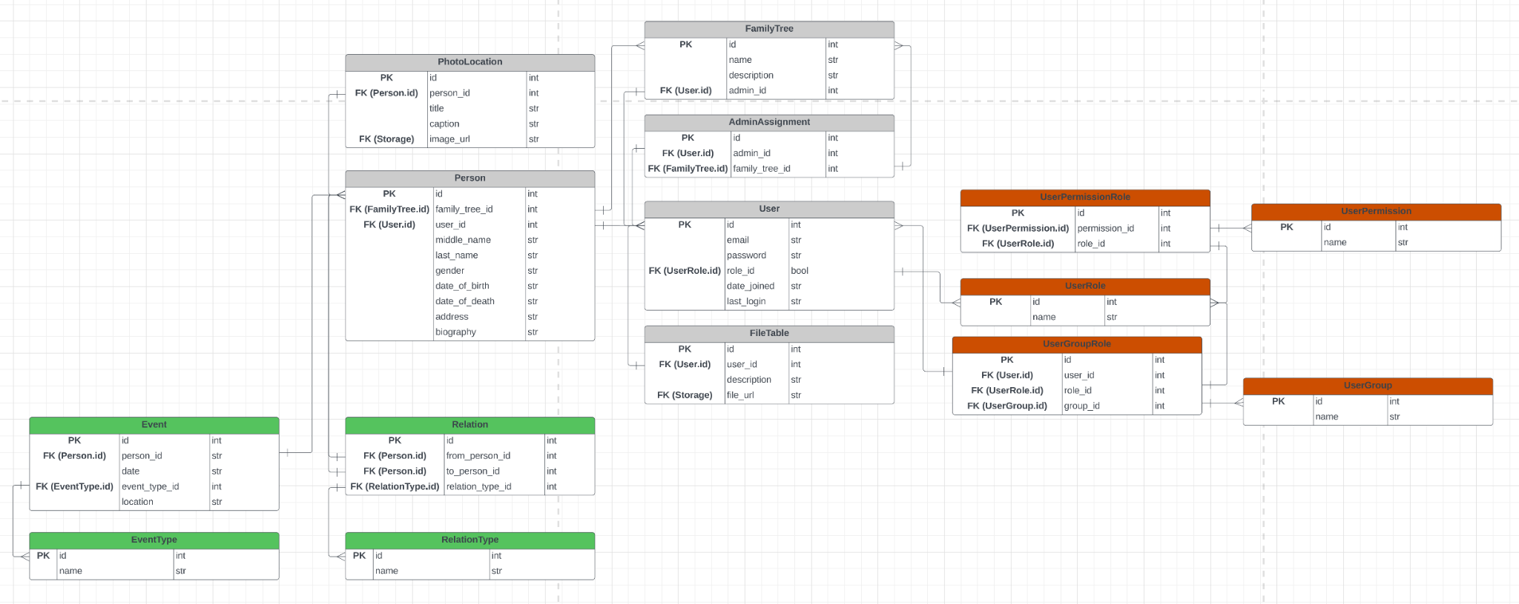
Database Schema

Slide 7
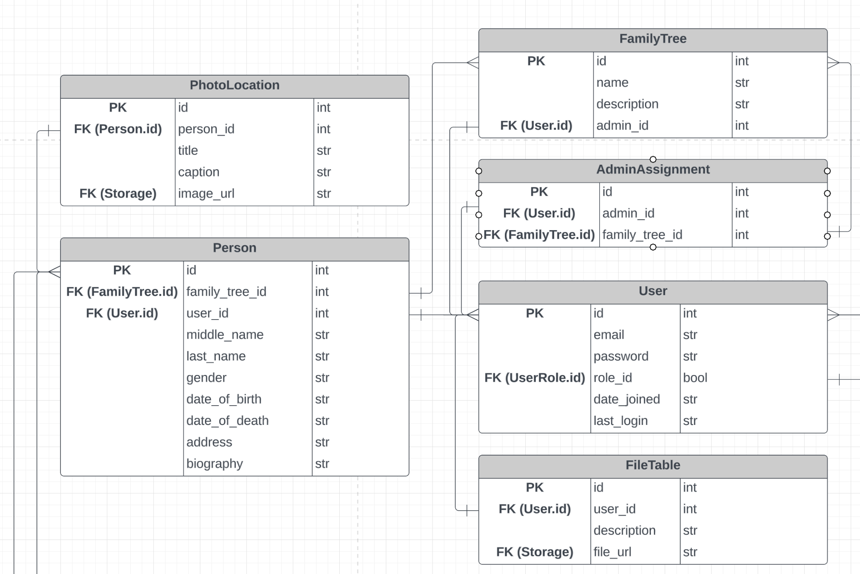
Database Schema

Slide 8
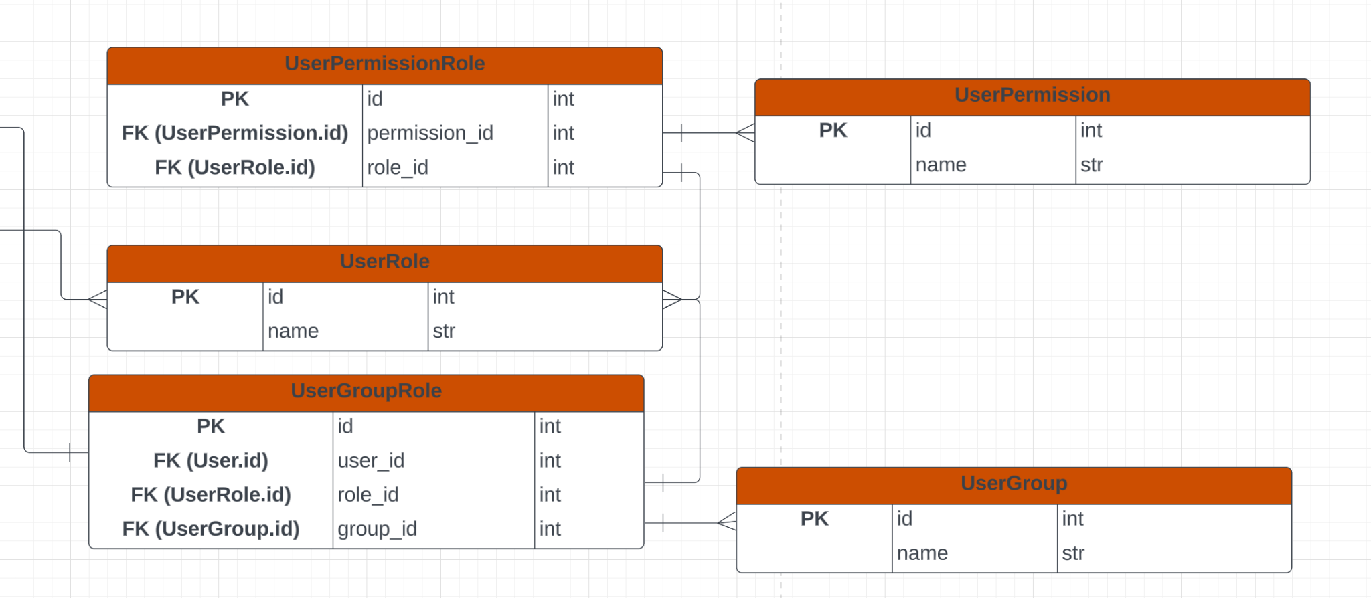
Database Schema

Slide 9
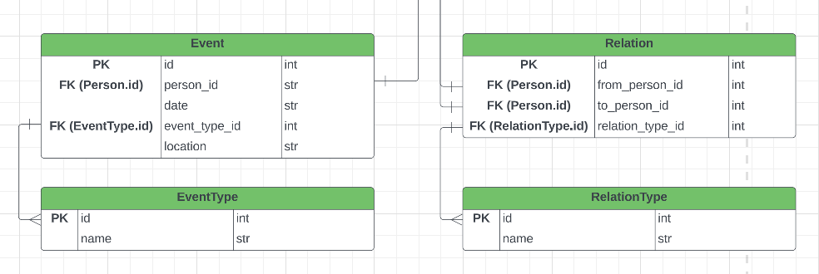
Database Schema

Slide 10
Graphical User Interface (GUI)

Slide 11
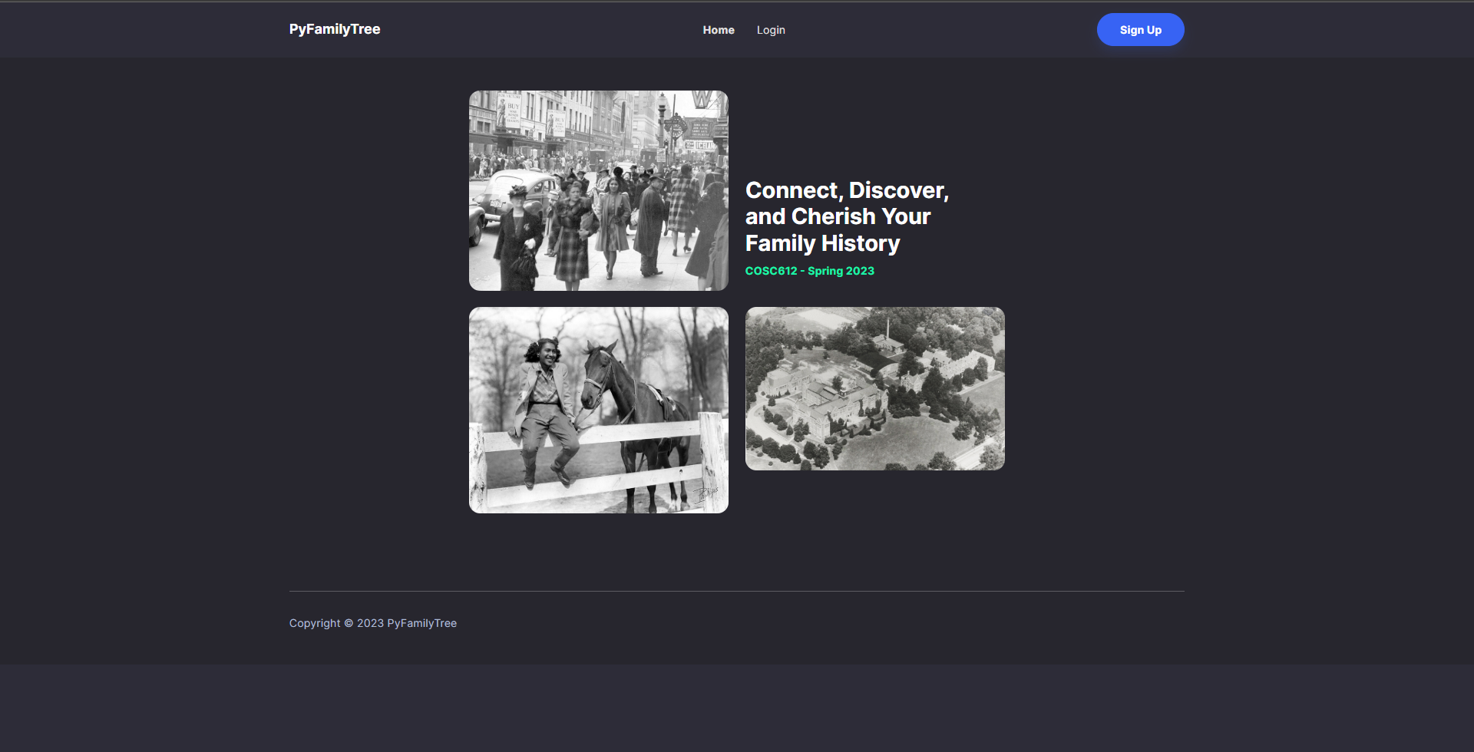
GUI ID 1: Home Page

Slide 12
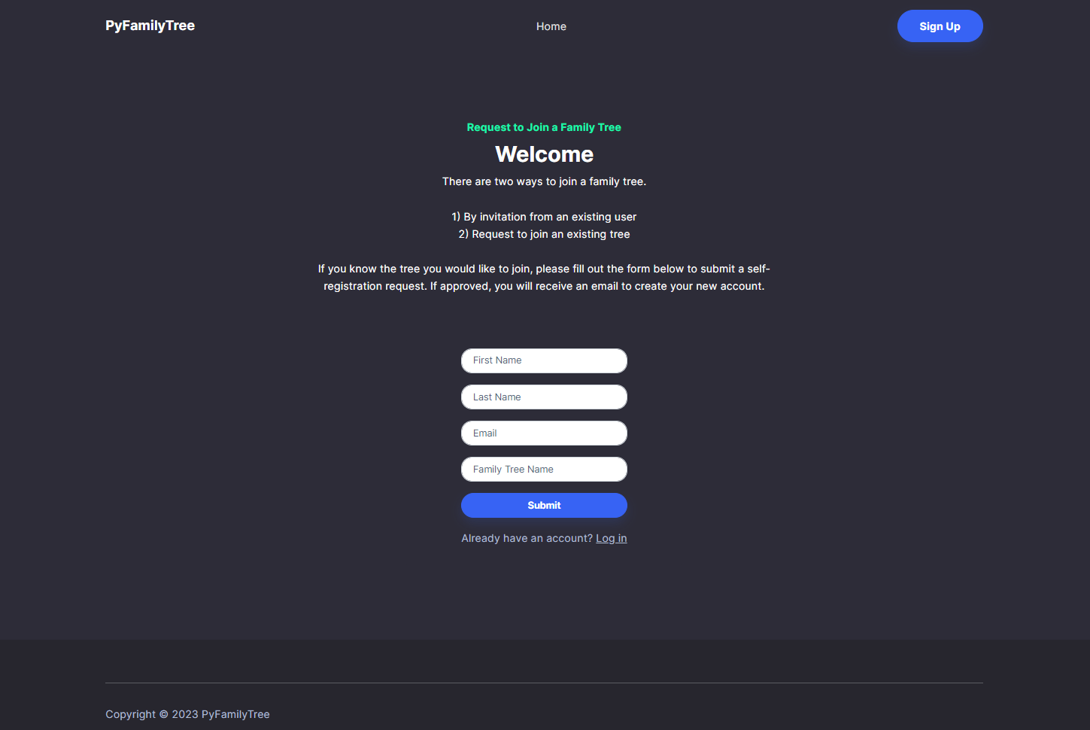
GUI ID 3: Registration

Slide 13
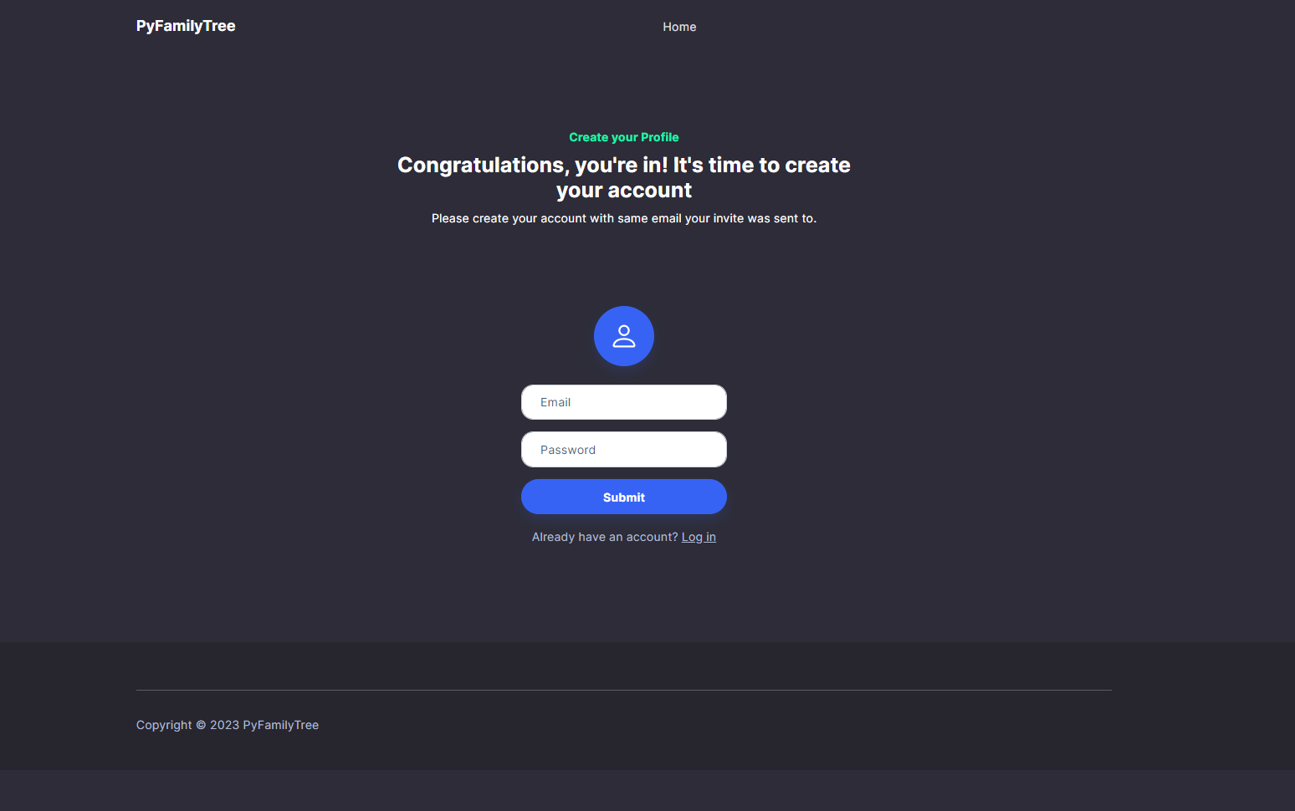
GUI ID 4: Create Profile

Slide 14
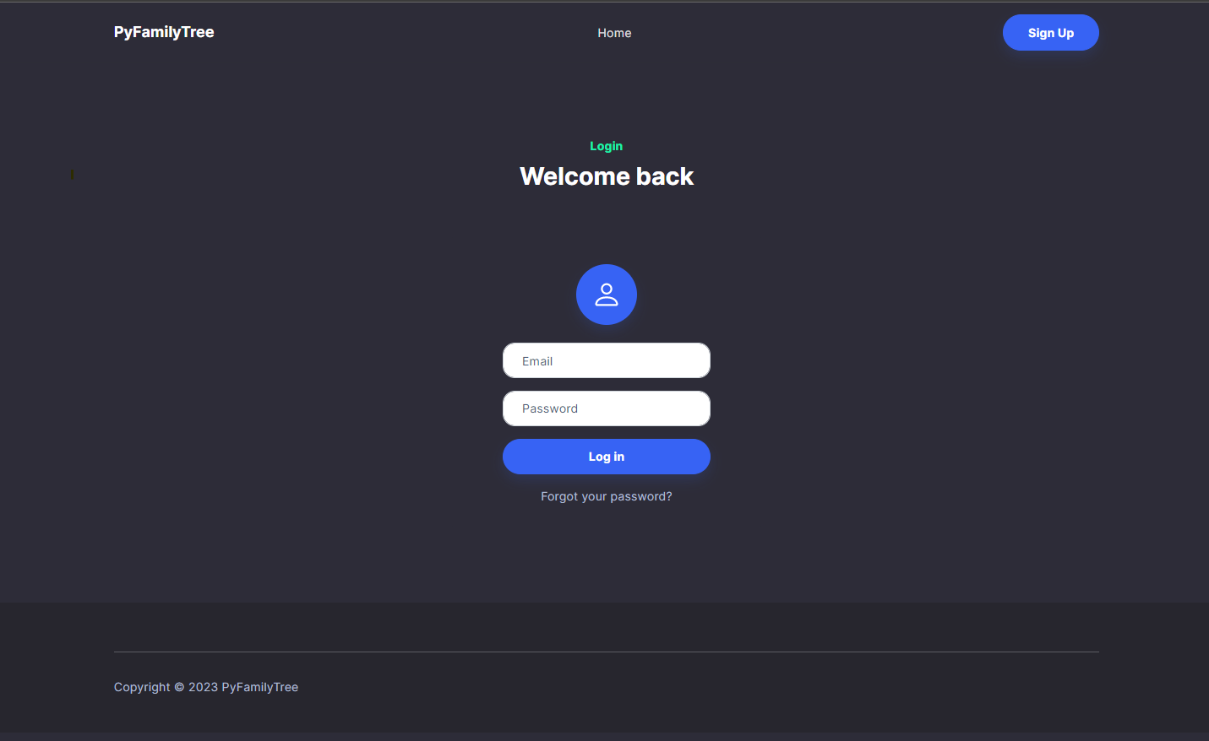
GUI ID 2: Login

Slide 15
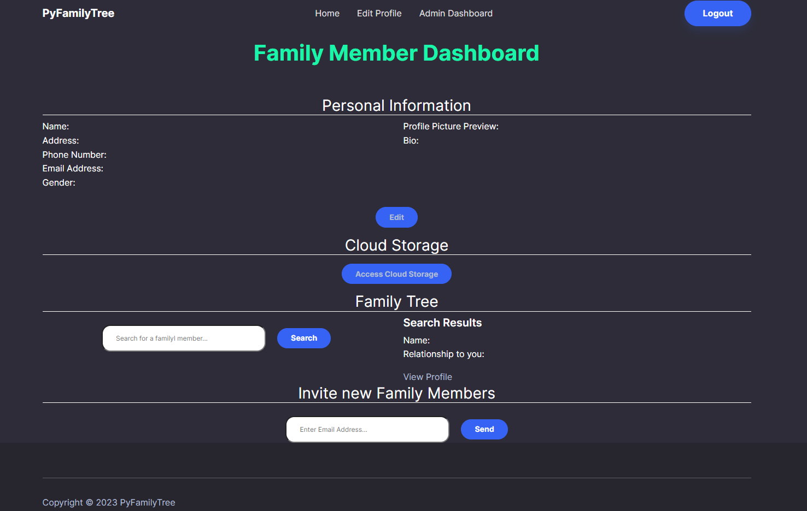
GUI ID 7: Member Dashboard

Slide 16
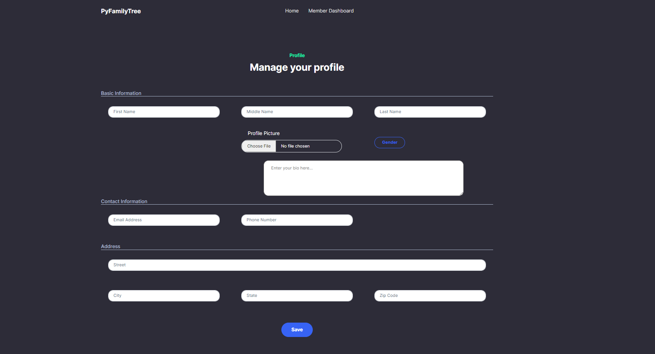
GUI ID 5: Edit Profile

Slide 17
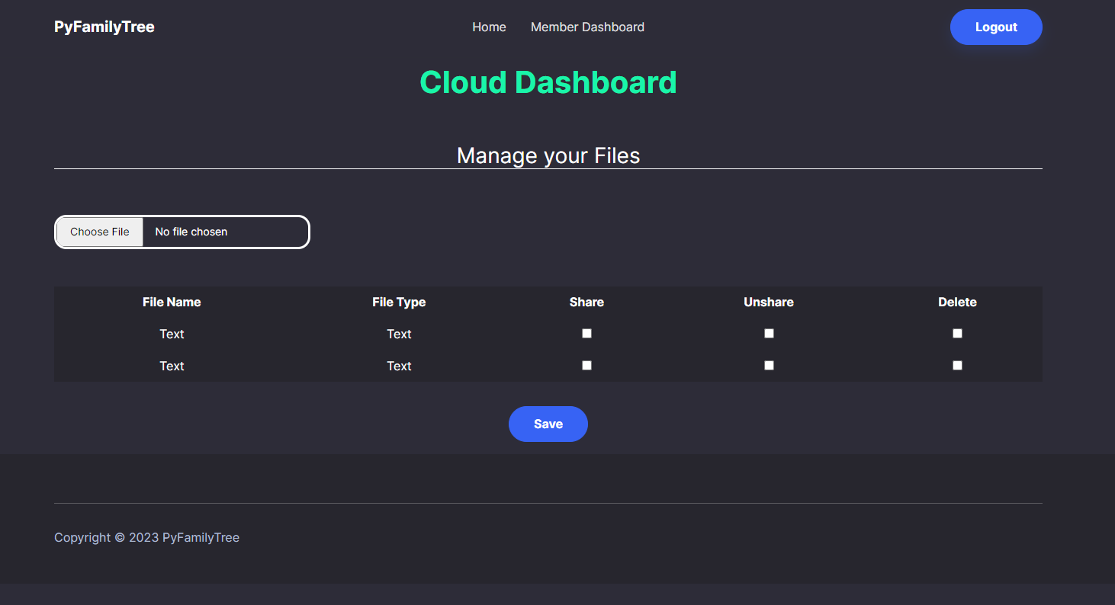
GUI ID 9: Cloud Dashboard

Slide 18
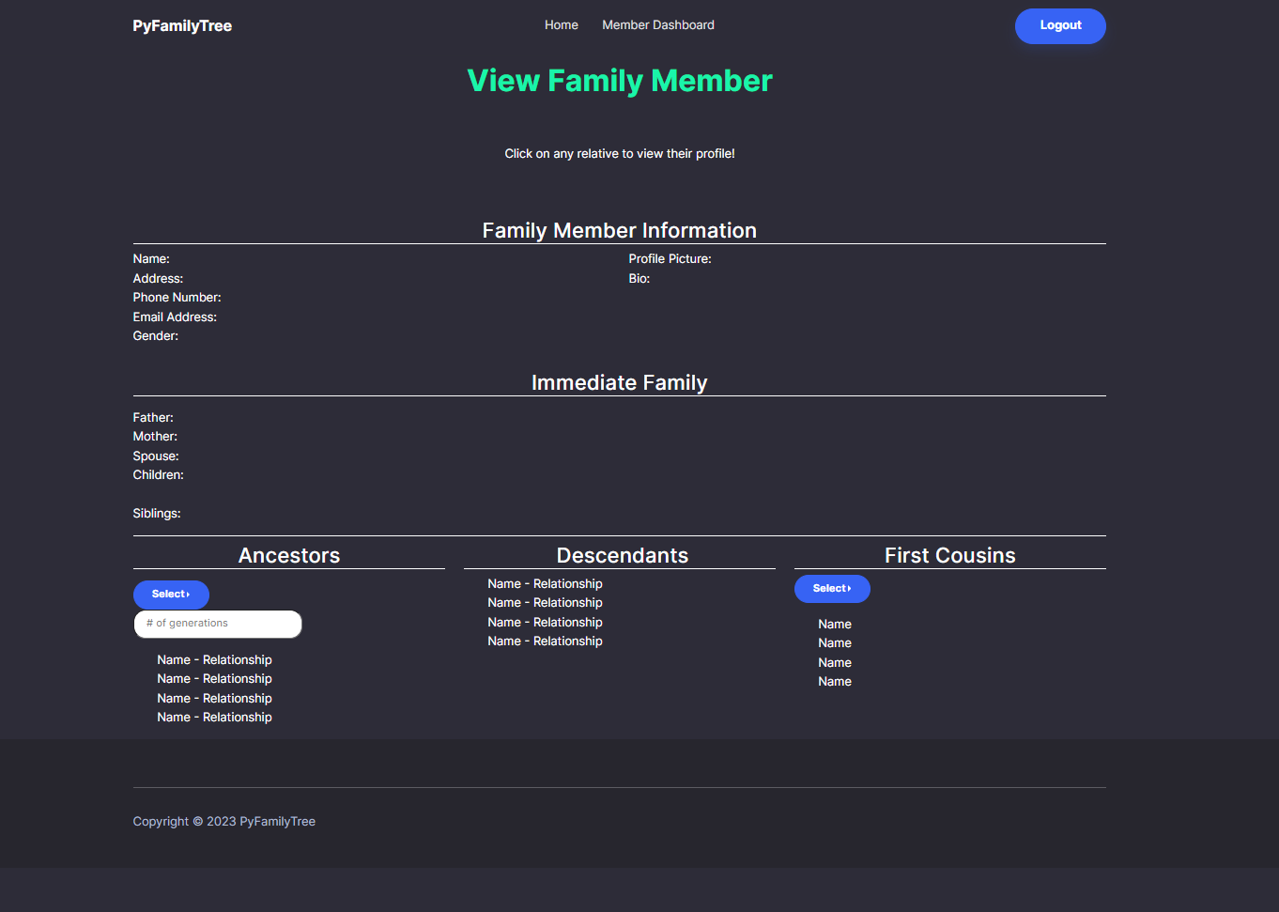
GUI ID 6: Member Information

Slide 19
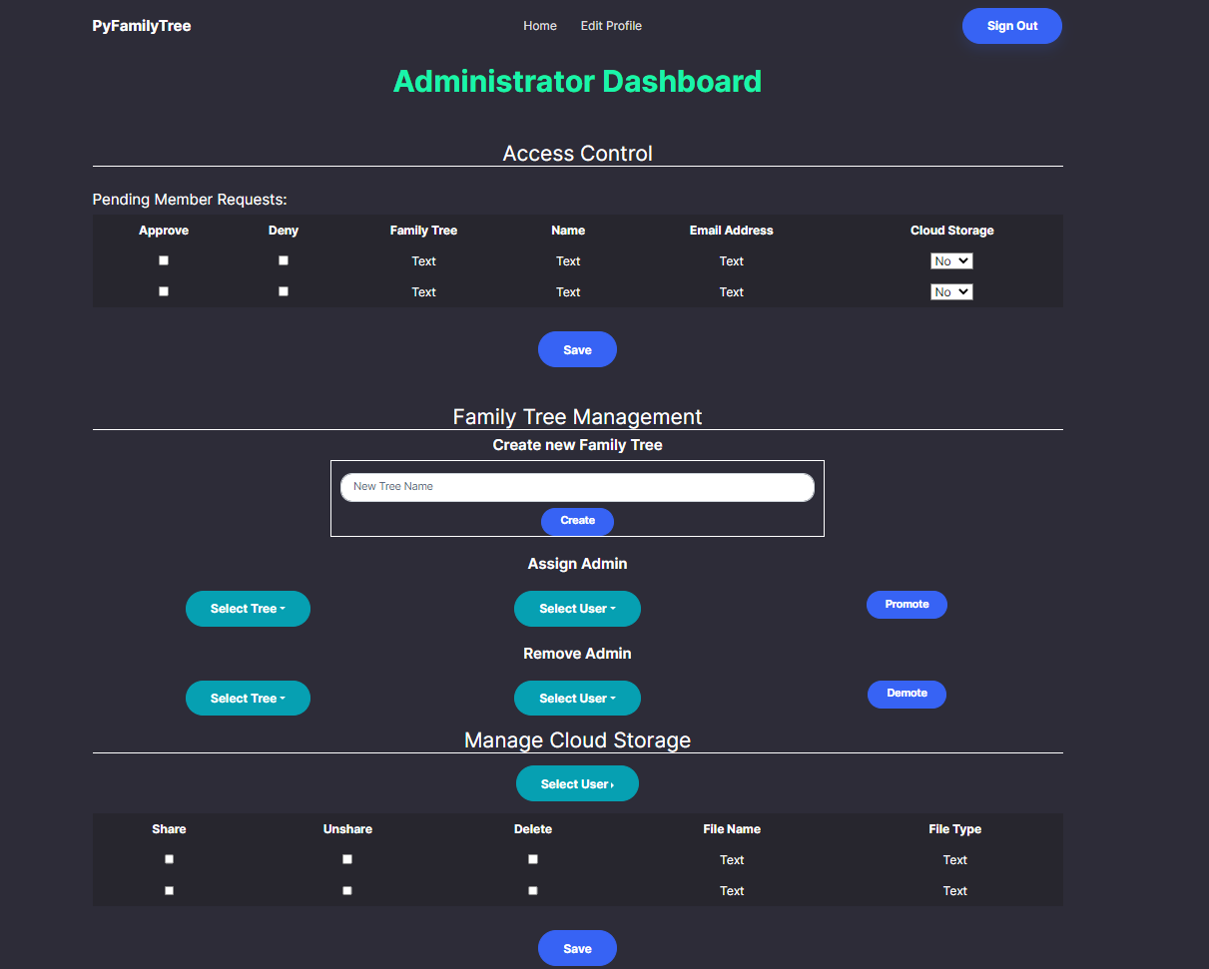
GUI ID 8: Administrator Dashboard

Slide 20
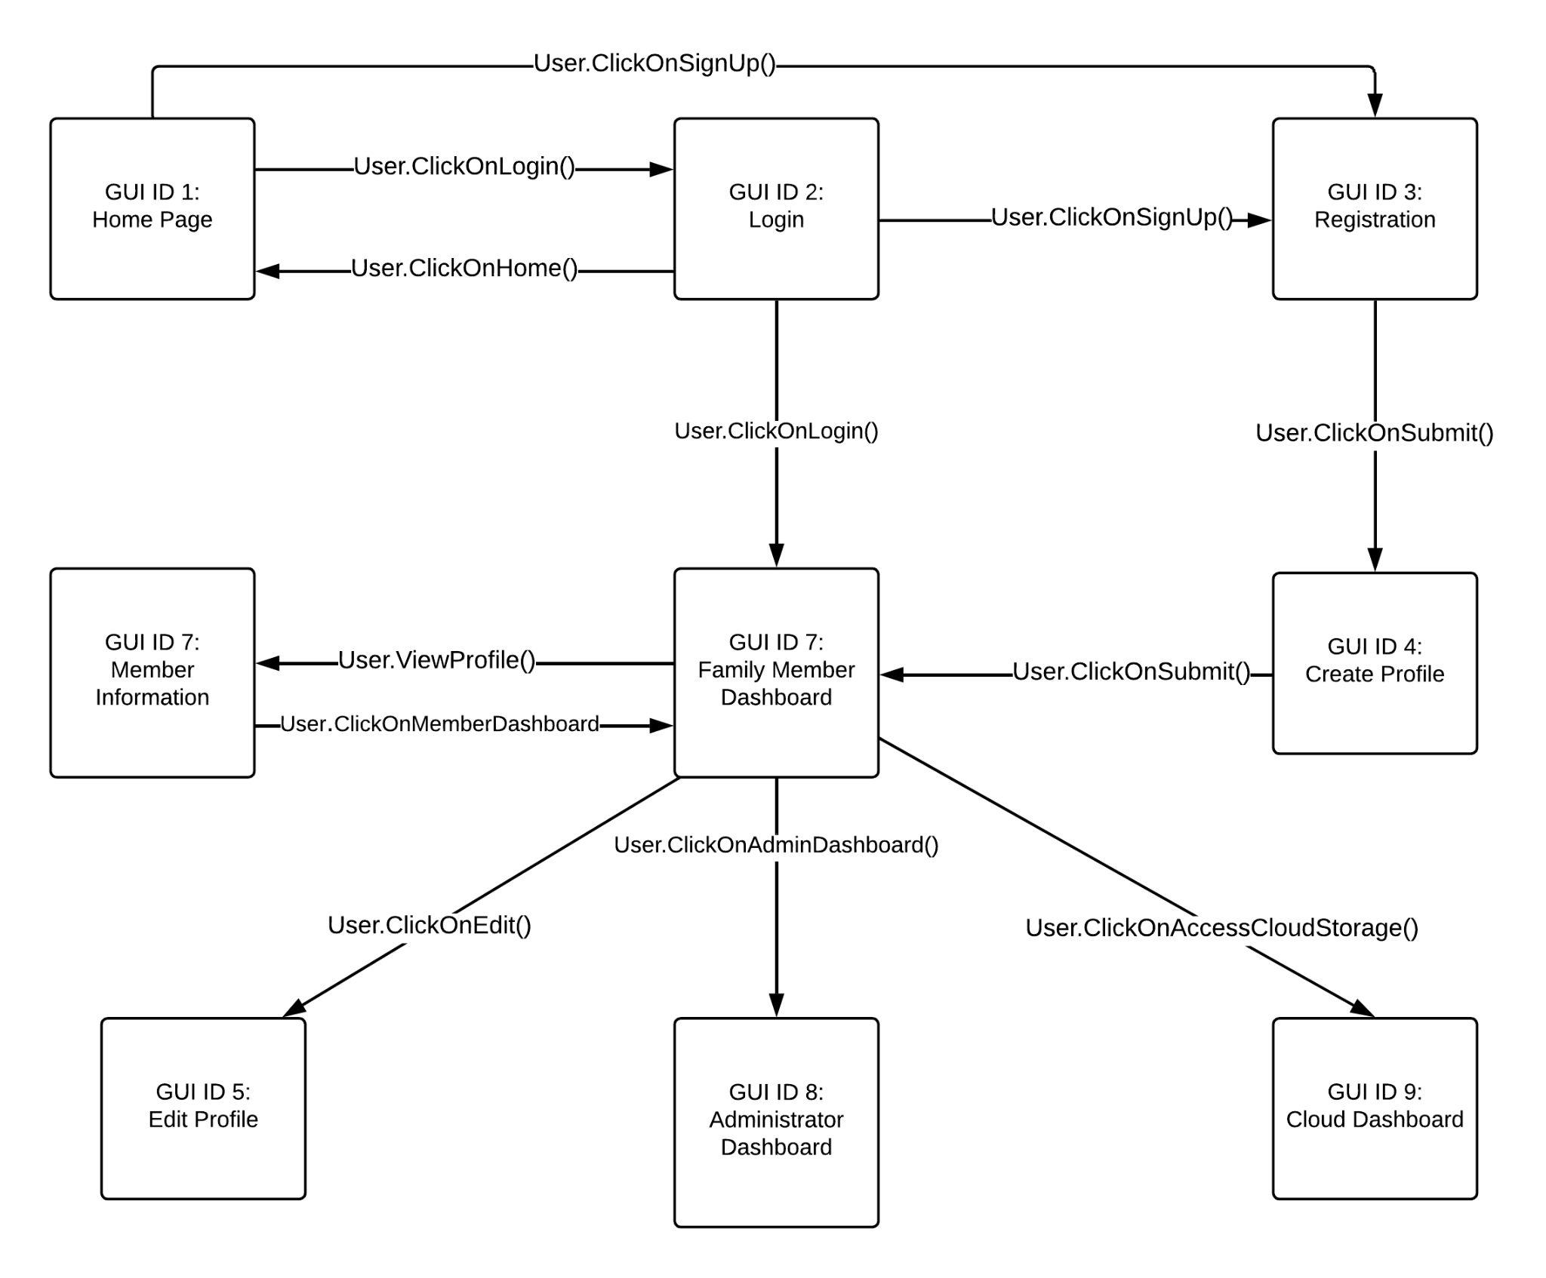
GUI Transition Diagram

Slide 21
Sequence Diagrams

Slide 22
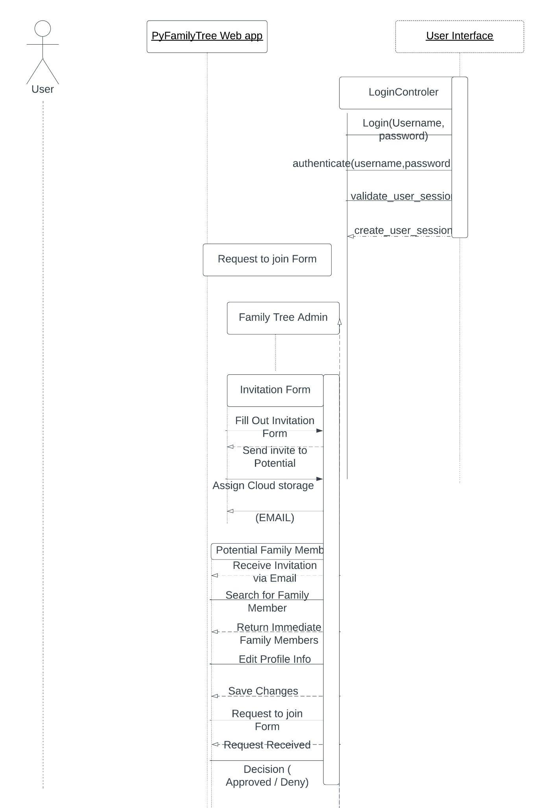

Slide 23
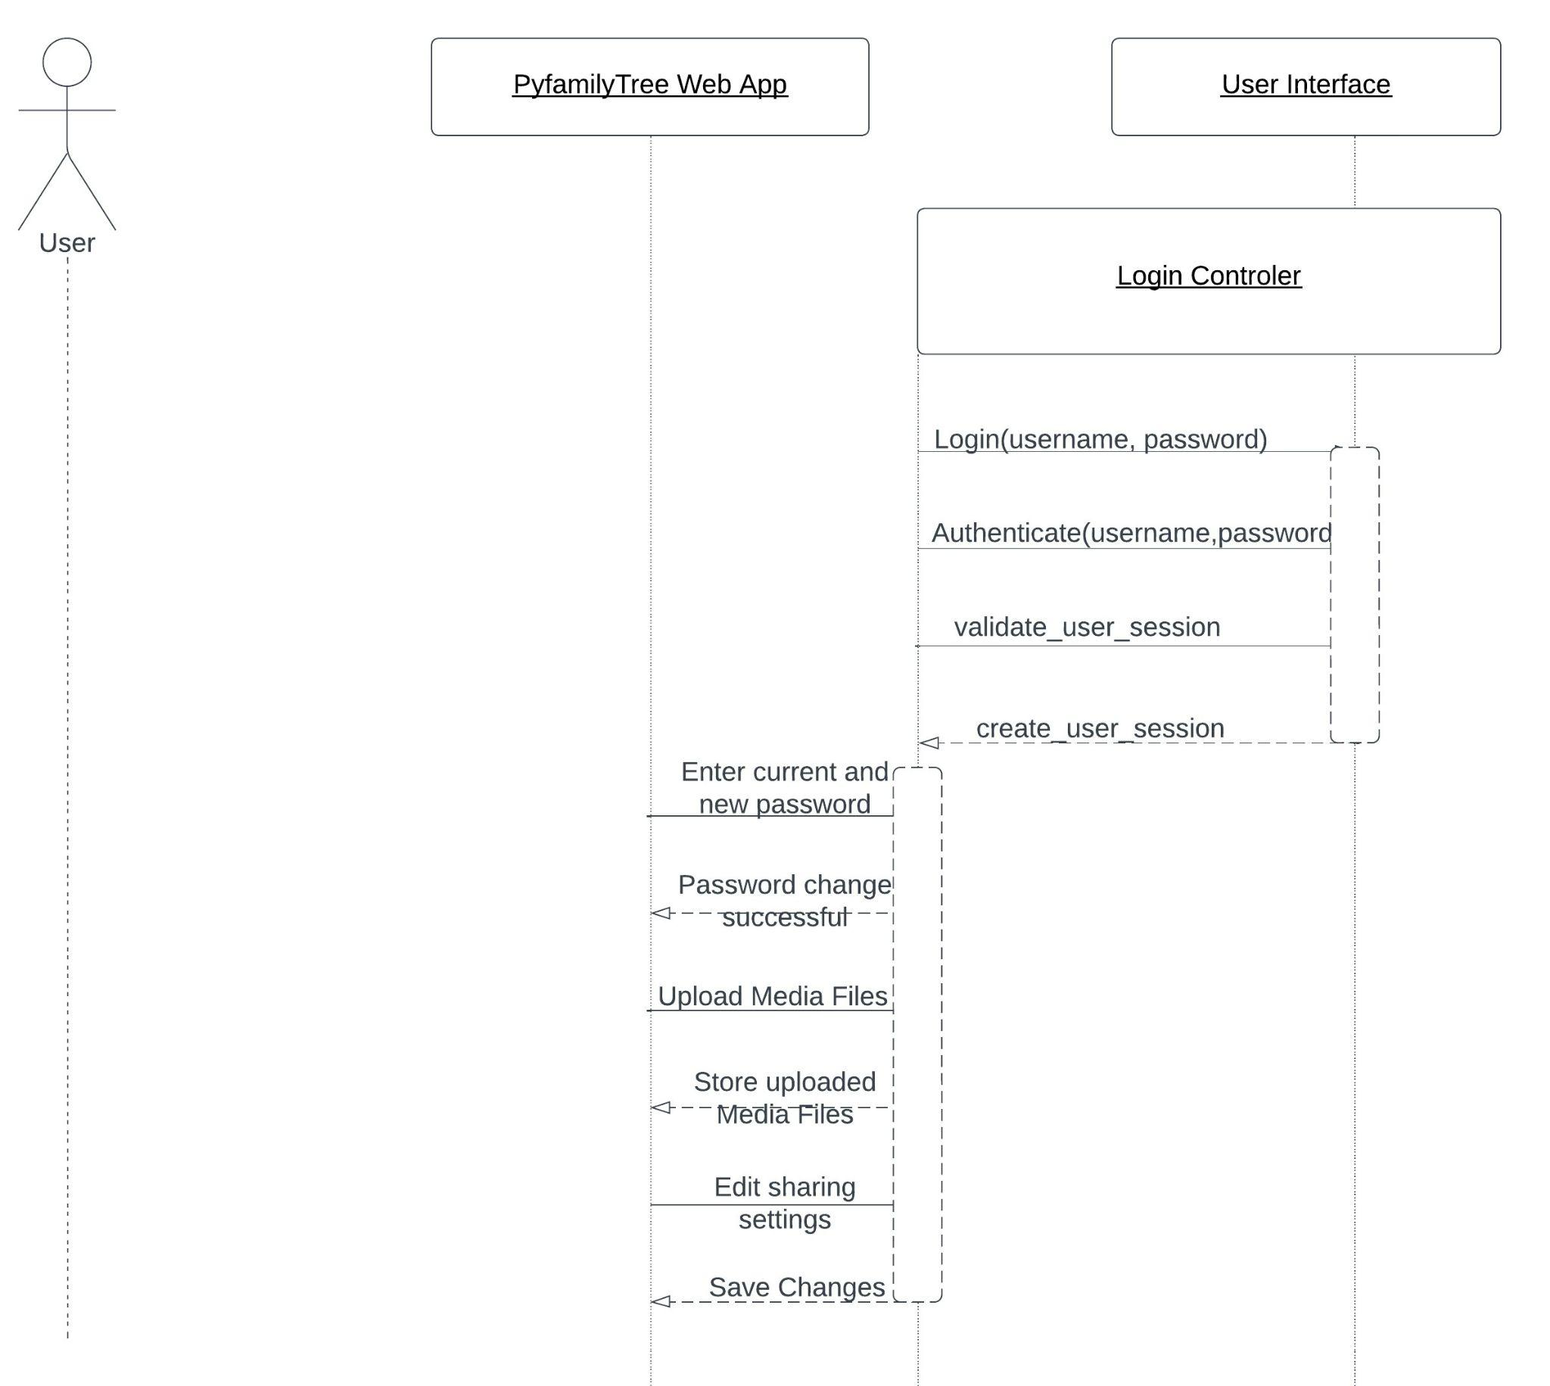

Slide 24
User Manual Sample
New Family Tree Creation:
Login to the system with Super admin credentials
Click on the “Create Family Tree” button located on the dashboard.
Fill in the necessary details, such as family name and family description.
Once all details are entered, click on the “Create” button to submit.
The new family tree is now created and ready to use.
Assigning an Admin to an Existing Family:
Login to the system with Super admin credentials
Click on the “Admin” tab on the dashboard
Search for the family you wish to assign an admin to and click on it.
Click on the “Add Admin” button and fill in the details of the person you want to assign as the admin.
Once all details are entered, click on the “Add” button to submit.
The admin is now successfully assigned to the family.

Slide 25
Conclusion
System Architecture
Database Schema
GUI
GUI Transition Diagram
Sequence Diagrams
User Manual Sample

Slide 26
Questions?

